Slide 1
Socio-economic Disparities in Health
Vinish Shrestha
Lecture 5

Slide 2
Introduction
Previous chapter
Grossman model
Health can be chosen – you can choose the type of diet. Mainly depends on time constraints, budget constraints, and utility
Optimal health (H*) depends on tradeoffs

Slide 3
This Chapter
How does socioeconomic status (SES) affect health?
Correlation versus causality
Does health determine SES or does SES determine health?
Income and health
Education and health
Use empirical findings to explore

Slide 4
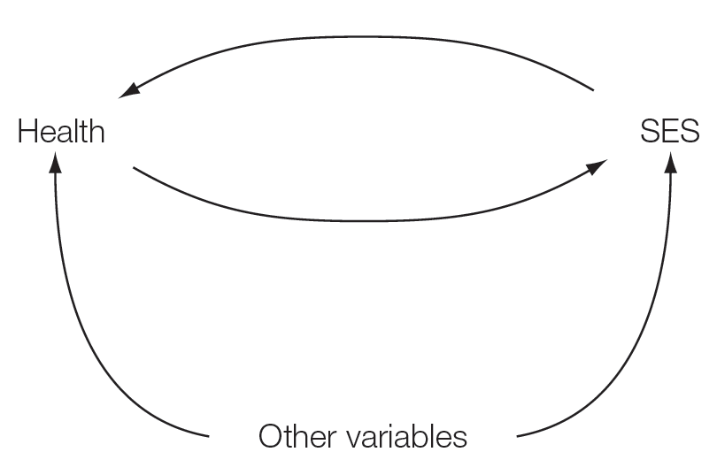
Cause and effect

Slide 5
Cause and effect
Reverse causality
Does higher income lead to better health or it is the other way around?
Note that we viewed health as a form of human capital in the Grossman model.
Omitted variables
Are there other variables affecting both health and socioeconomic status?
Ability, environment (location), parent’s education….

Slide 6
Correlation and Causality
Correlation: Basically tells you how two variables move together (say X and Y)
Negative correlation between distance away from school and attendance
But does this mean that distance away from school has a causal effect on attendance?
SELECTION BIAS: Students living far away from school may have a preference of not having much value in attending school regularly. Only a selected students with peculiar value for education lives far away from school.
Correlation does not mean causality
Remember you stat class

Slide 7
Causality
Harder to prove.
Saying that X causes Y. Increase in income leads to better health.
How do we approach causality in applied micro-economics?
Natural Experiments
Instruments
Randomized control trials

Slide 8
Natural Experiments
Experiments provided by the nature, environment, or institutional policies
It eliminates selection bias
Say data shows you that better maternal education leads to better child health outcomes.

Slide 9
Mother’s education and child health
Does it necessarily mean that mother’s education leads to improvements in child health?
Mother’s who decide to get higher education may be diligent, more able (higher ability), more risk averse, and have a low discount factor
Education in this case suffers from selection bias
Note that these factors are not observed by researchers. But can they themselves affect health?
IF yes, no causation, just correlation

Slide 10
Using natural experiments
A natural experiment would
Affect mother’s education but not other factors which can affect child health
Any effect on child health comes through increase in education
Examples: Increase in colleges in the U.S. Used by Currie and Moretti (2003). The authors find that high maternal education improves child health (birthweight and mortality)
Education policy: National Education System Planning (1971) in Nepal, which was built to improve primary education standards. Show that increase in education reduces child mortality, reduces child labor, and improves children’s education
We can use natural experiments to track the effect of SES on health.

Slide 11
Using Natural Experiments
A natural experiment
(say an educational
Policy), increases education
of mothers
but does not affect other factors directly.
this helps us track the causal effect of
mother’s education on child health.
Child Health
Mother’s Education
Third Factor
(SES, ability, determination,
Risk preferences)
External Event
(natural experiment)

Slide 12
A randomized control trial
Would be ideal but highly unethical
Randomly divide girls into two groups. Provide high quality education for group X and low quality for group Y
Follow them throughout their lifetime
And track health
Highly highly unethical
But studies have been carried out using cash-transfer programs

Slide 13
Theoretical Reasons behind Health Disparity
Early life events
Income level (Income-Health Gradient)
Education (Education-Health Gradient)
Stress
Work Capacity
Adherence to medical advice

Slide 14
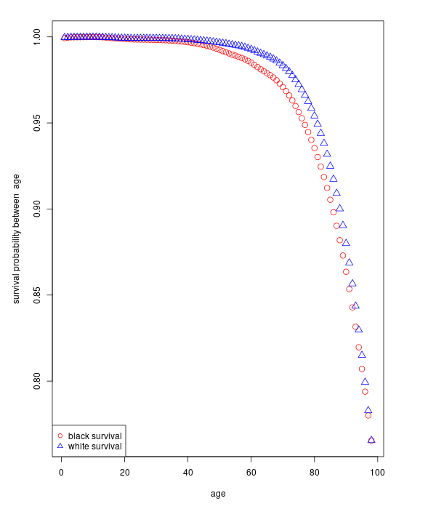
By Race
Data:NVSS, 2006

Slide 15
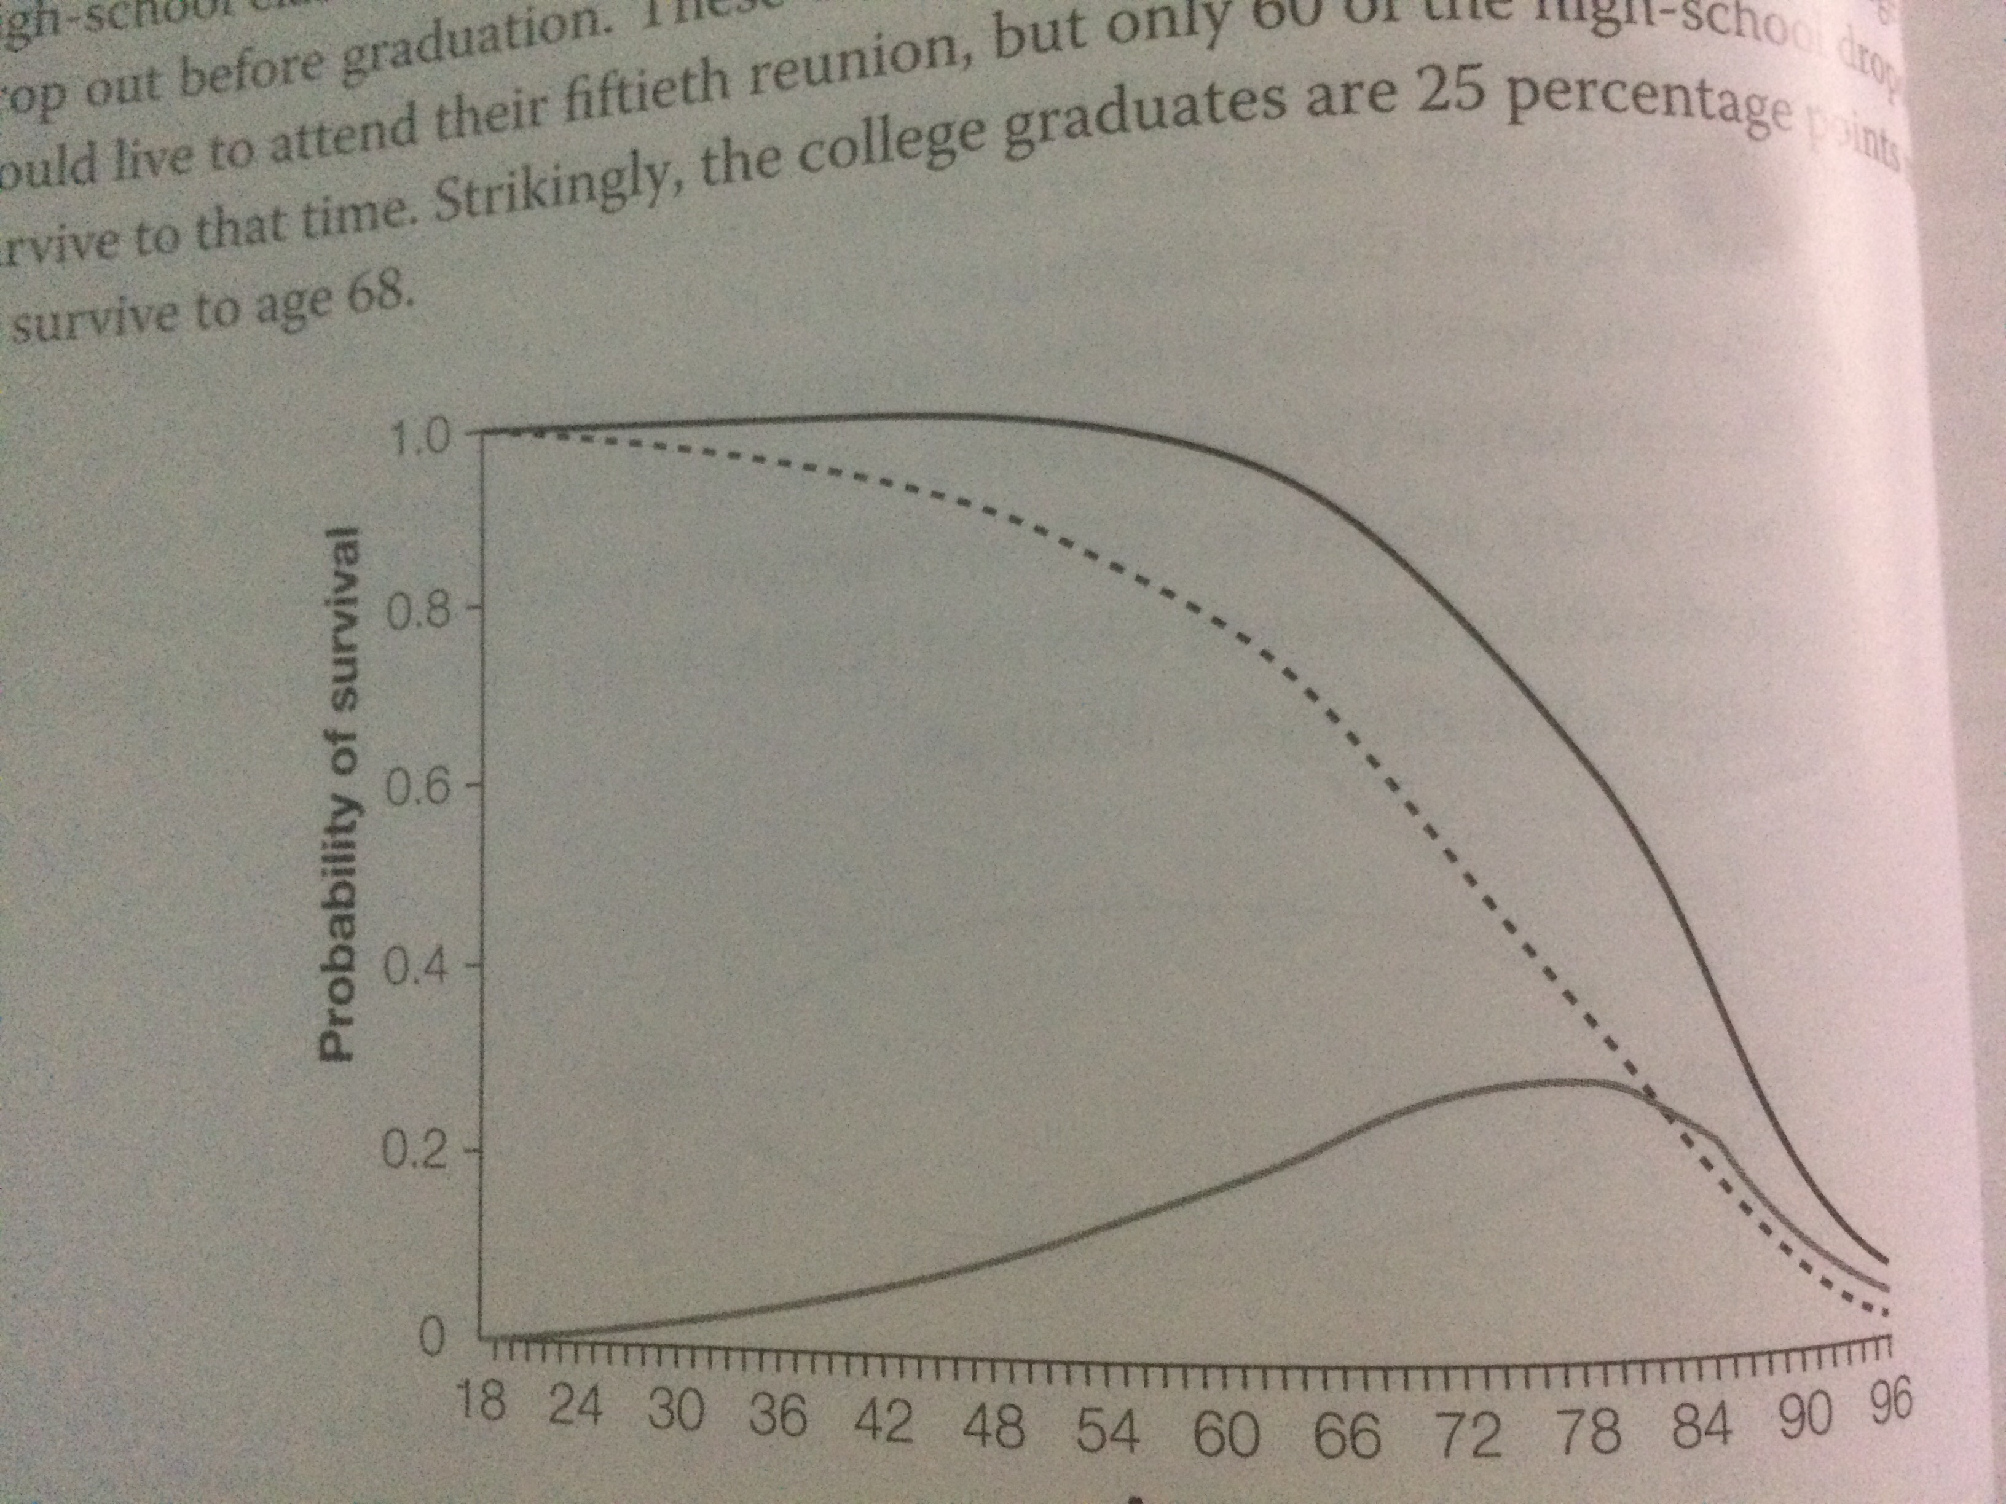
The pervasiveness of health inequality college grads, high dropouts and difference in survival

Slide 16
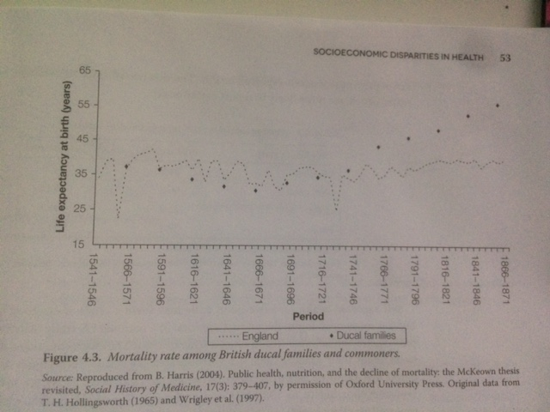
Historical Health Inequality

Slide 17
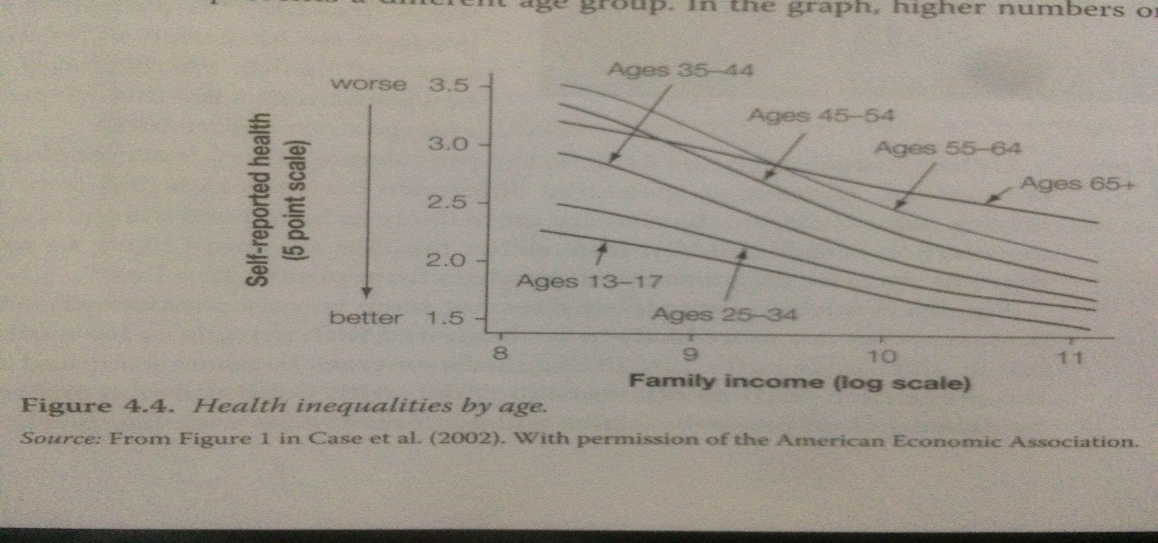
Disparity across income (rise of the gradient)

Slide 18
Disparity across education

Slide 19
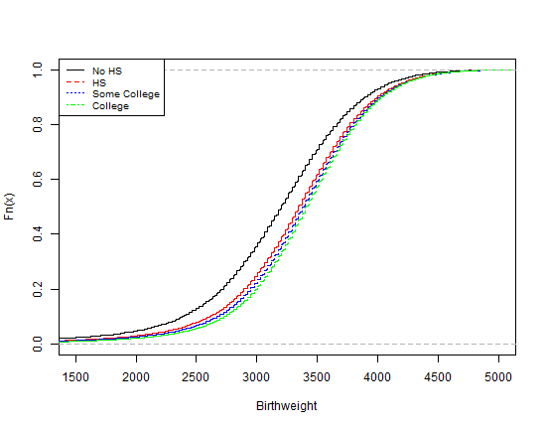
Disparity Across Education – Child Health
Source: NVSS 1990 and 2000

Slide 20
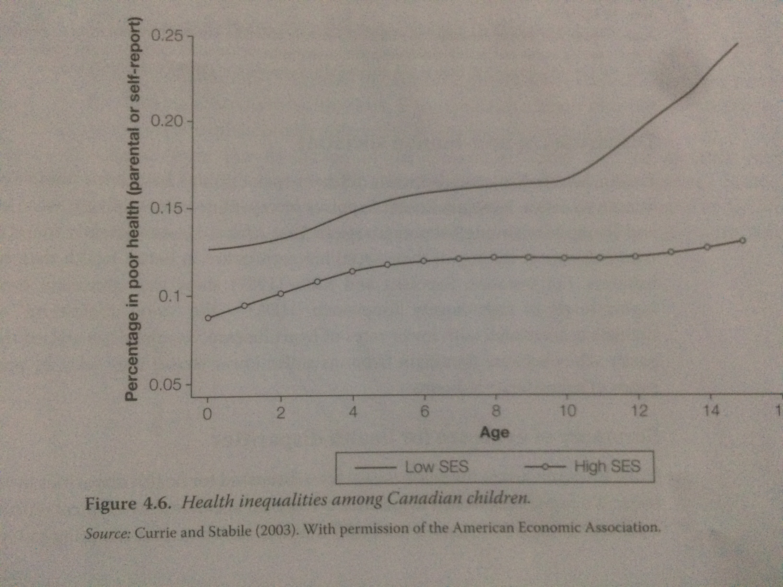
Disparity in countries with universal health insurance

Slide 21
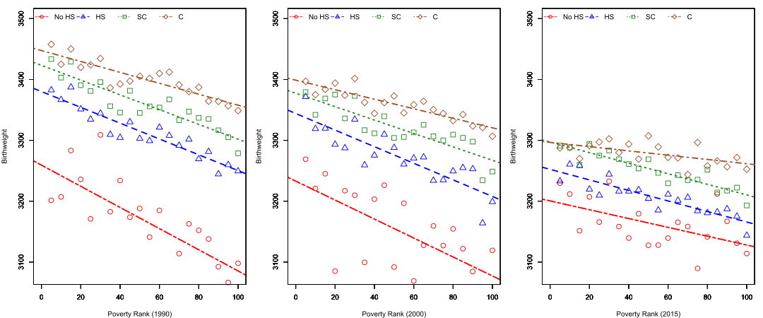
Interaction between Education and Income

Slide 22
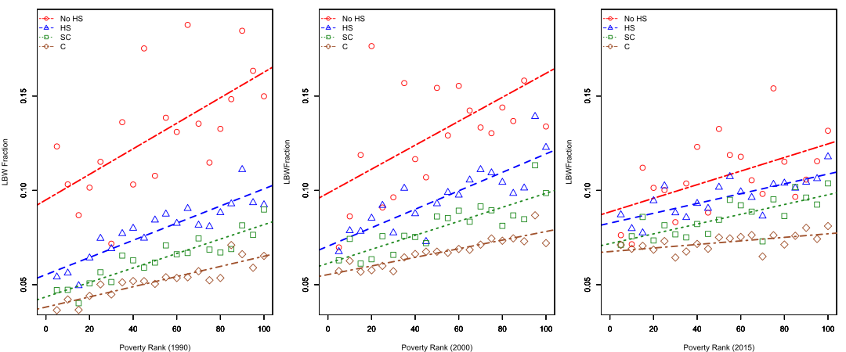
Interaction between Education and Income

Slide 23
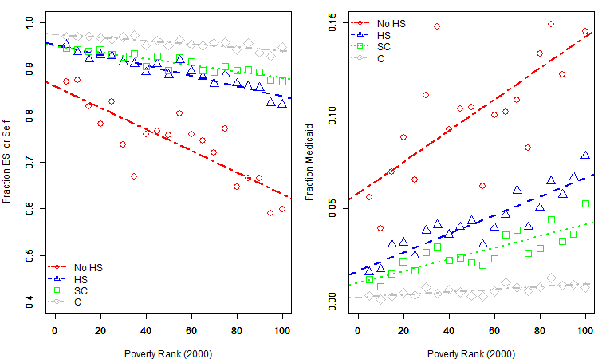
Interaction between Education and Income

Slide 24
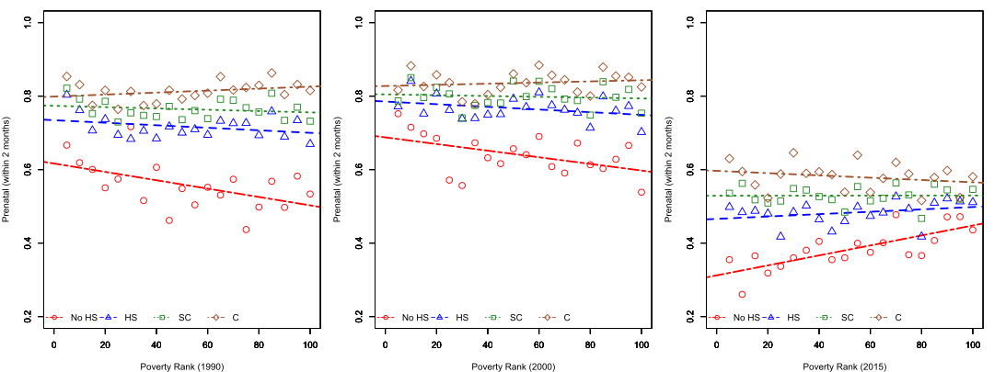
Interaction between Education and Income

Slide 25
Hypothesis to explain health disparity
Efficient producer (Allocative and productive efficiency)
Income
Allostatic load
Income Inequality
Access to care
Time preference (The Fuchs hypothesis)

Slide 26
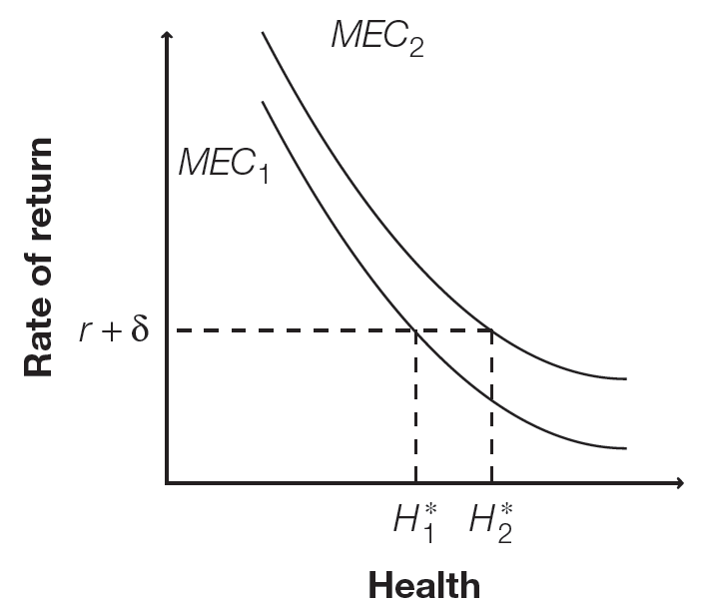
What does grossman model has to say about Health Disparity?

Slide 27
Review of mec (marginal efficiency of capital)
How does an additional improvement in health affects the rate of return?
Different SES groups can have different MECs
Why?
Each hypothesis gives different reasons
Allocative efficiency is higher among educated individuals

Slide 28
The efficient producer hypothesis
Efficient producer hypothesis: better educated individuals are more efficient producers of health compared to less well-educated individuals.
Due to productive and allocative efficiency
Productive efficiency: Given the same inputs, educated individuals can produce better health
E.g. interpreting doctors advice
Allocative efficiency: can pick inputs such a way that can lead to better health
Diet

Slide 29
The efficient producer hypothesis
School lessons can provide better information to take care of themselves
Smoking and drinking
Form a higher discount factor (future matters more)
Better-educated are more likely to adhere to treatment regimens

Slide 30
Thrifty phenotype hypothesis (Barker hypothesis)
Health outcomes throughout lifetime are determined by deprivation of resources (food) in early childhood or even in utero
Develop genes which can adapt to harsh environment (store fat during famine), but lead to relatively poor health in environment with abundant resources
Develop diabetes, obesity
High correlation between SES and resource deprivation in early life. Hard to isolate.

Slide 31
The Dutch famine study
Natural experiment: Dutch famine in WWII (Rosebloom et al. 2001)
Holland suffered a famine due to a German blockade of food
Created two baby groups:
Those in utero during famine
Those conceived after famine
Two groups are similar, except for in utero deprivation
So hopefully no selection bias!
Findings:
Babies in utero during famine had higher rates of diabetes and obesity in adulthood
The thrifty phenotype hypothesis

Slide 32
A natural experiment using ramadan
Almond et al. (2014) uses period of Ramadan as a natural experiment
Pakistani and Bangladeshi families in England
Fasting for a month (begins at dawn and ends at sunset)
Find lower academic outcomes for children at age 7 those who were exposed to Ramadan in early pregnancy

Slide 33
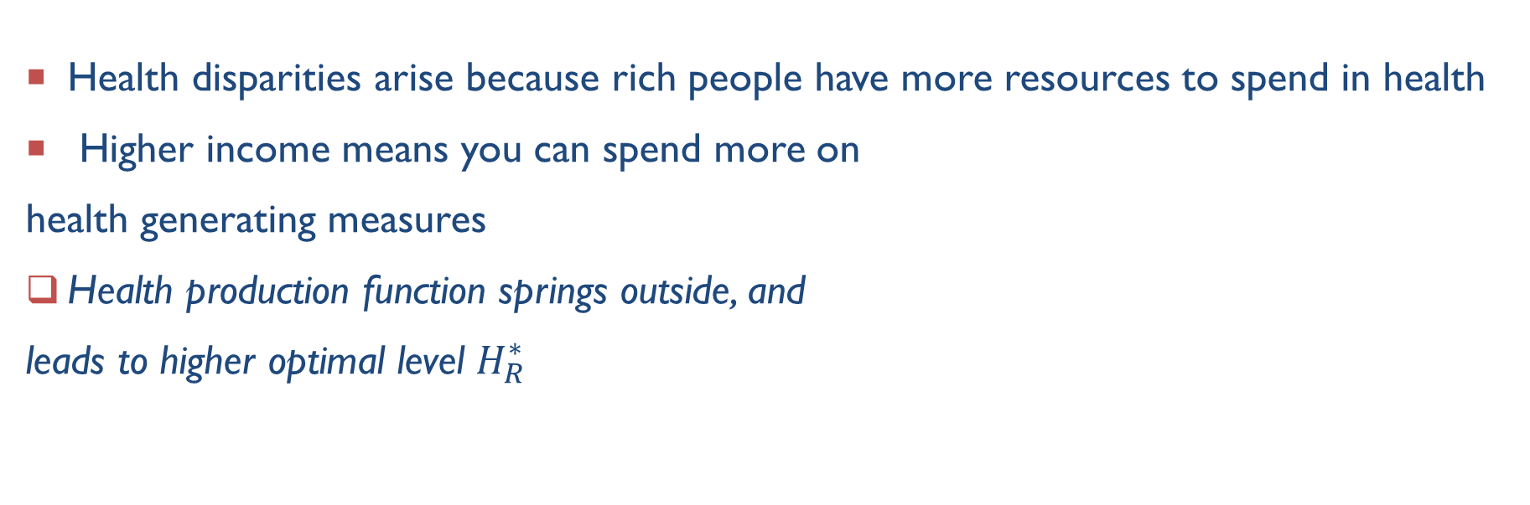
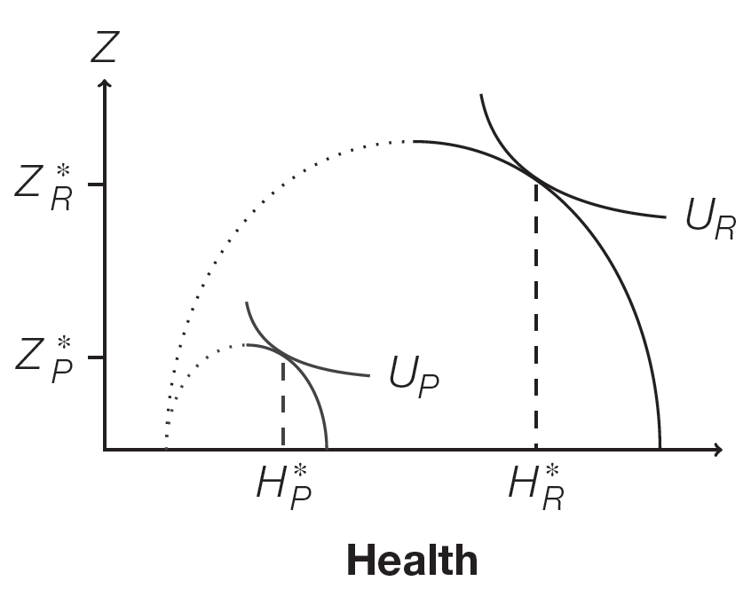
The direct income hypothesis

Slide 34
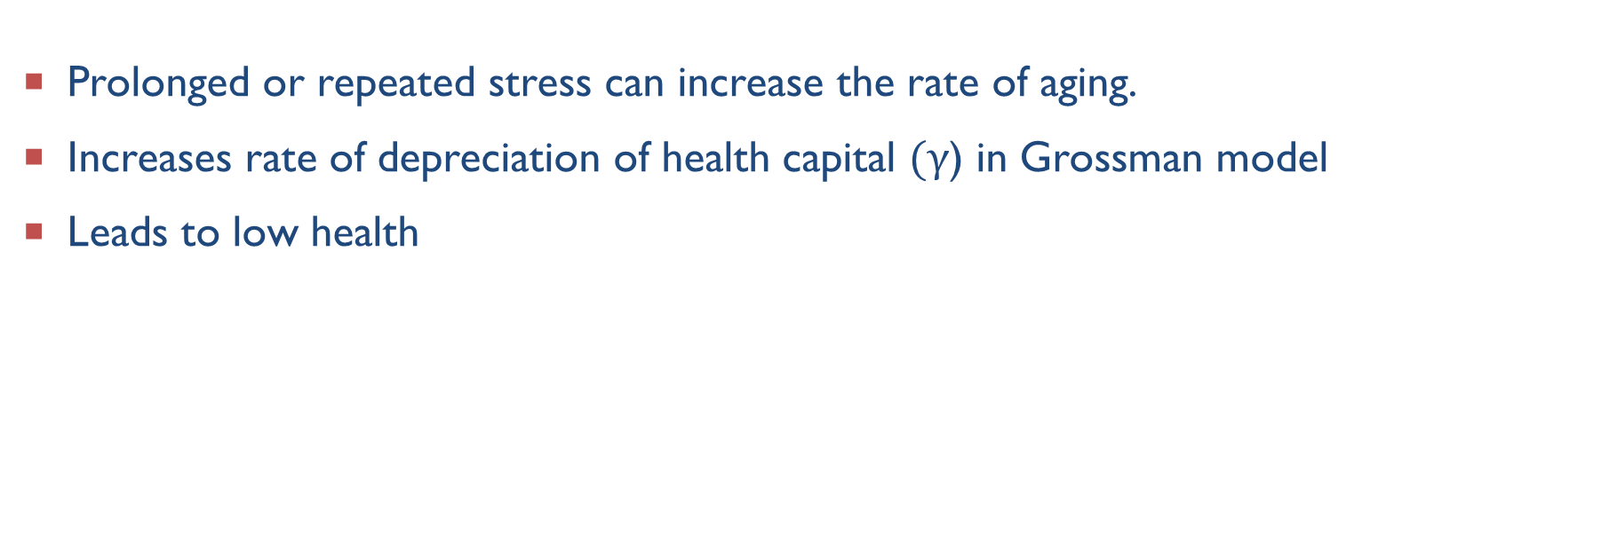
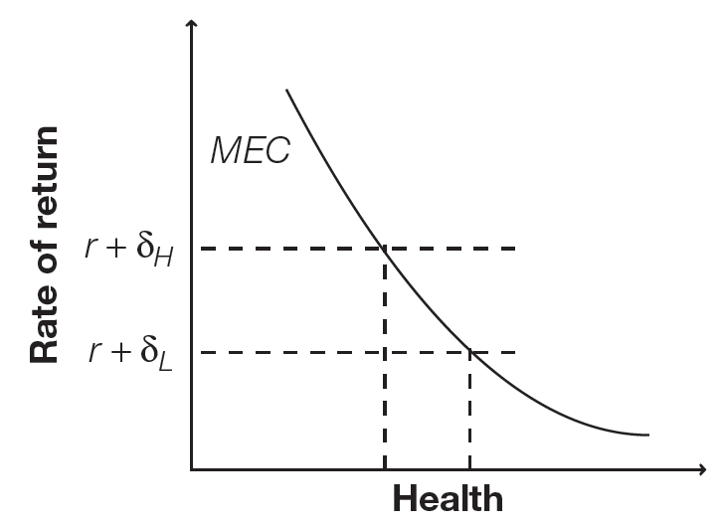
Allostatic load hypothesis
Prolonged or repeated stress can increase the rate of aging.
Increases rate of depreciation of health capital ) in Grossman model
Leads to low health

Slide 35
The Whitehall study
Conducted by Marmot et al. (1978, 1991)
Track health status of British civil servants from the beginning of their career
People who apply and become civil servants are homogenous in backgrounds and workplace environment
Morbidity and mortality are highest among the lowest-grade civil servants
Report stressful work and home environments
Any drawbacks?

Slide 36
Access to care hypothesis
Hypothesis: Those with high incomes can afford more generous health insurance compared to those of low income
But health disparities persist in countries with universal health insurance
Canadian youth (Currie and Stabile 2003)
British civil servants (Marmot et al. 1978, 1991)
both countries have equal access to health care!
There is more to it!
The access to care hypothesis

Slide 37
The Fuchs hypothesis
Bad health does not cause low SES, and low SES does not cause bad health
A third factor – time preference -- causes both!
Health and SES both determined by willingness to delay gratification
People who are willing to delay gratification are more willing to invest in things like education and health
People willing to delay gratification have high discount factors δ
The Fuchs hypothesis

Slide 38
Questions (Show these on graphs related to grossman model)
How can increase in maternal education affect child’s health? Show this on a graph.
How can increase in household income affect health?
Increase in discount rate?

Slide 39
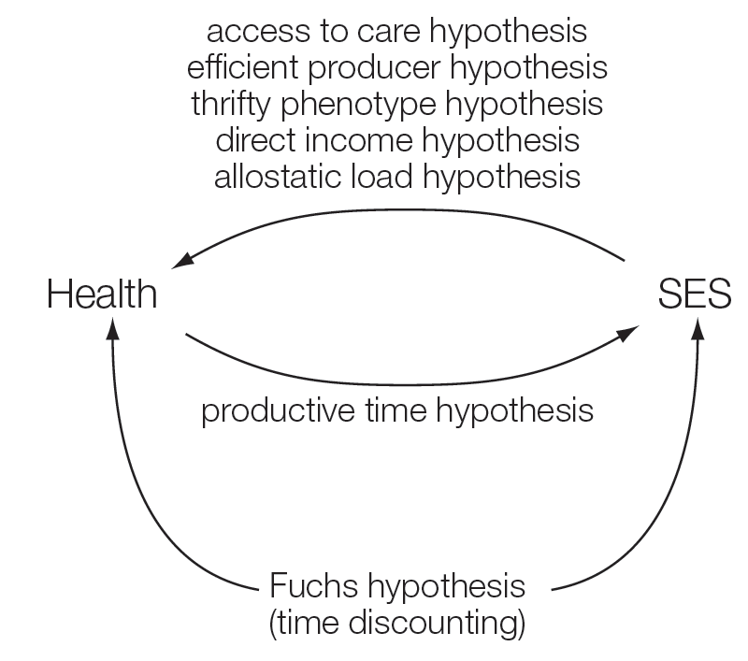
Conclusion
All hypothesis presented in this lecture carries empirical evidence
Key points
Education improves health (channels)
Health in early childhood
Stress
Equalizing access cannot eliminate disparity
Two way relation between SES and health

